Slide 1
E-COMMERCE WEBSITE -online shopping
Jayachandra Paul (187123)
Shanu Kumar (187159)
Hitender Singh Shekhawat (187122)

Slide 2
Purpose
It is an e-commerce website where a customer buy a product from online system and make a transction.If a customer doesn’t like to a product after delivered then he/she have an option to return the product within a time limit.

Slide 3
Functionality
A user login into the system from his id.
User choose the items as per his need.
User give his address,mobile no.,and some optional details.
Click on a confirm button and make payment.
Check his order status also in tracking section.
If user get fault product then he can return back the product.

Slide 4
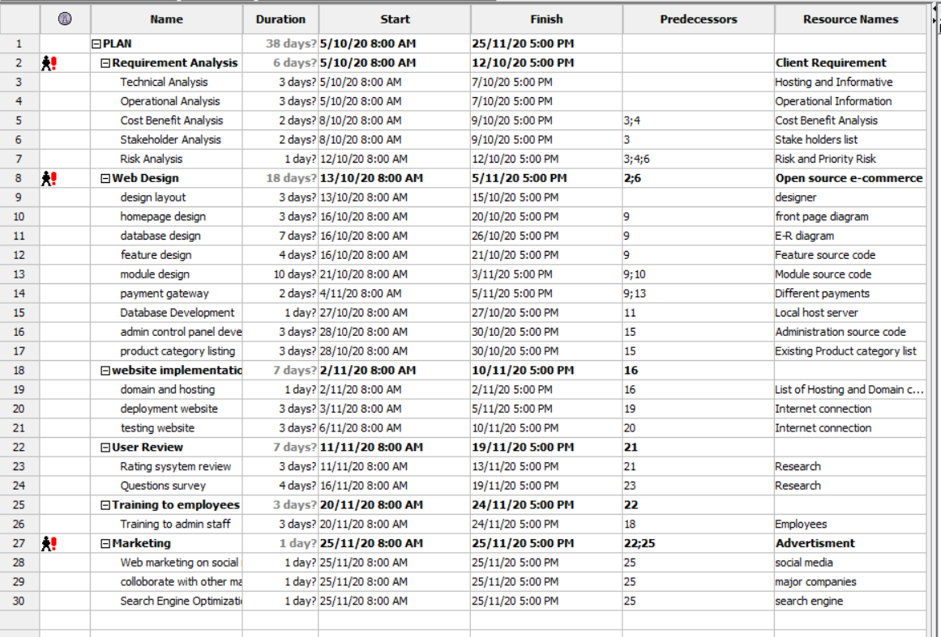
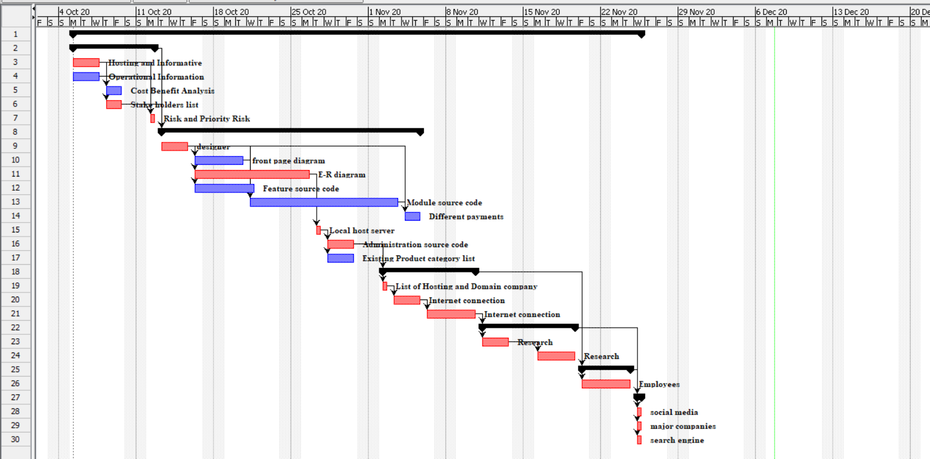
Gantt

Slide 5
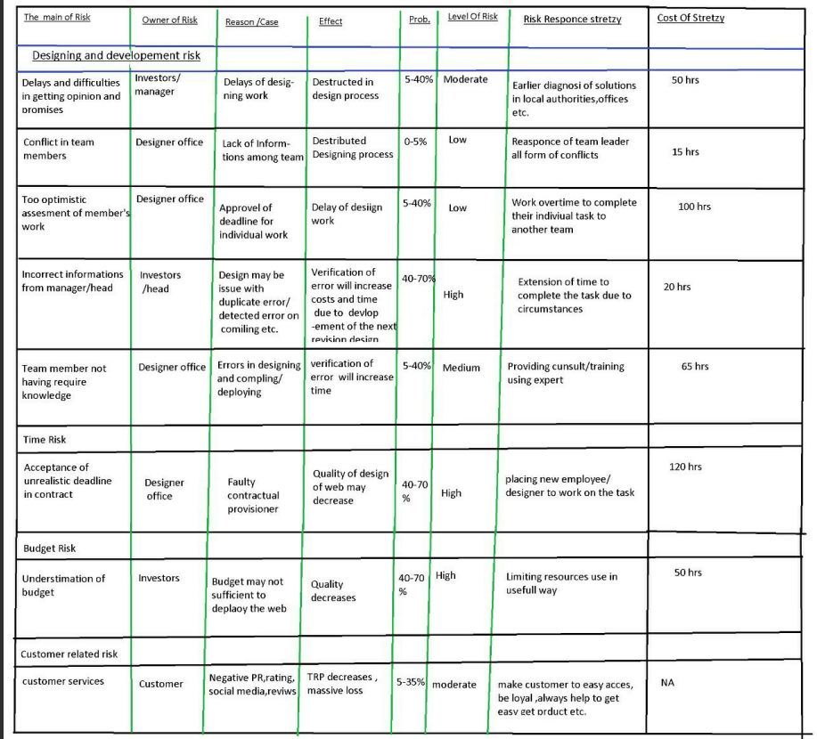
Feature Risk Matrix

Slide 6
SRS
Introduction
Purpose
Scope
Definations
References
Overview
Overall Description
Product Perspective
Product Functions
User characteristics
Principle Actors
General constraints
Assumptions and Dependencies

Slide 7
SRS continue….
Specific Requirements
Functional Requirements
Registration
Login
Changes to cart
Payment
Logout
Report Generation
Non-Functional Requirements
Security
24X7 availability
Reliability
Maintainabiltiy
Performance Requirements
Technical issues

Slide 8
SRS continue….
Interface Requirements
Software Interface
Hardware Interface
Communication Interface
System Design Specification
Architecture Design

Slide 9
Vision Document
Introduction
Positioning
Stakeholder and User Descriptions
Product Overview
Product Features
Constraints
Quality Ranges
Precedence and Priority
Other Product requirements
Documentation Requirements
Feature Attributes

Slide 10
WBS

Slide 11
RBS

Slide 12
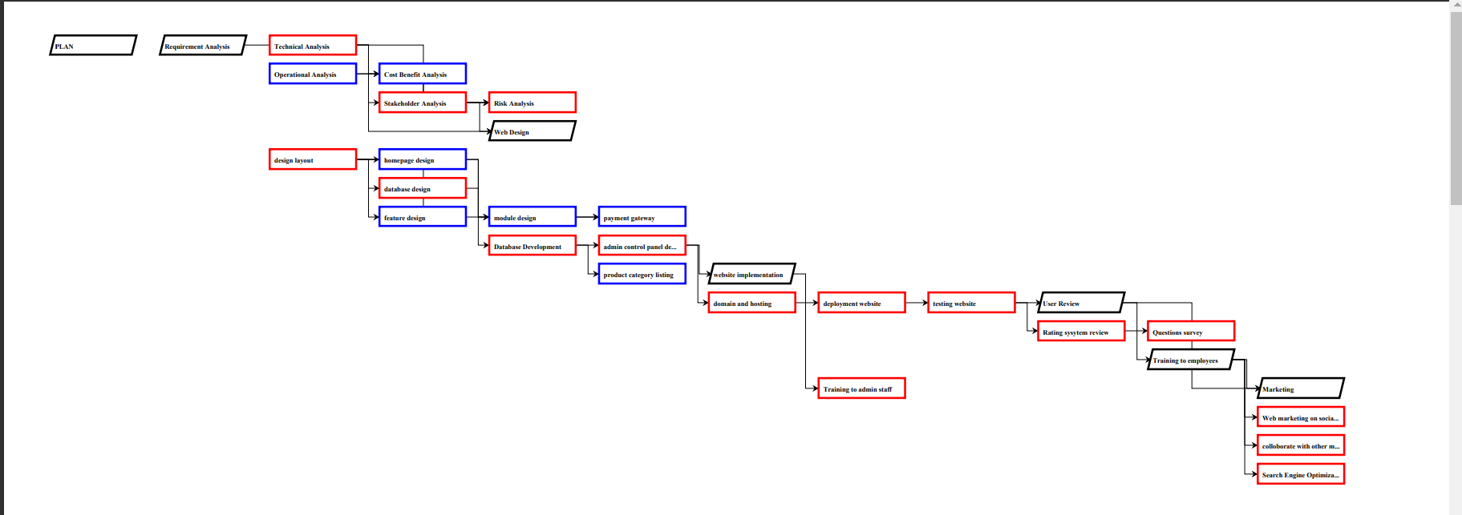
Network Diagram

Slide 13
Use Case

Slide 14
Risk

Slide 15
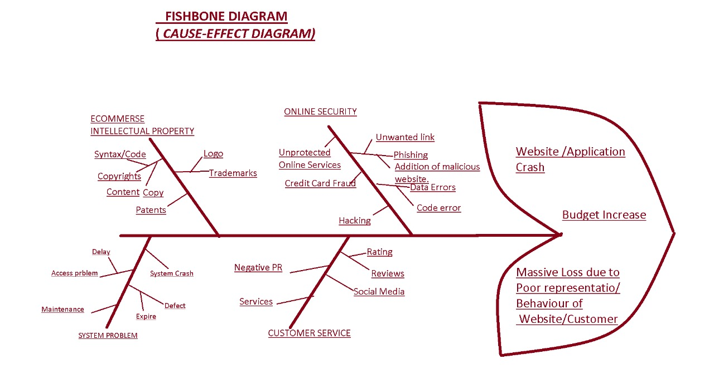
Fishbone Diagram

Slide 16
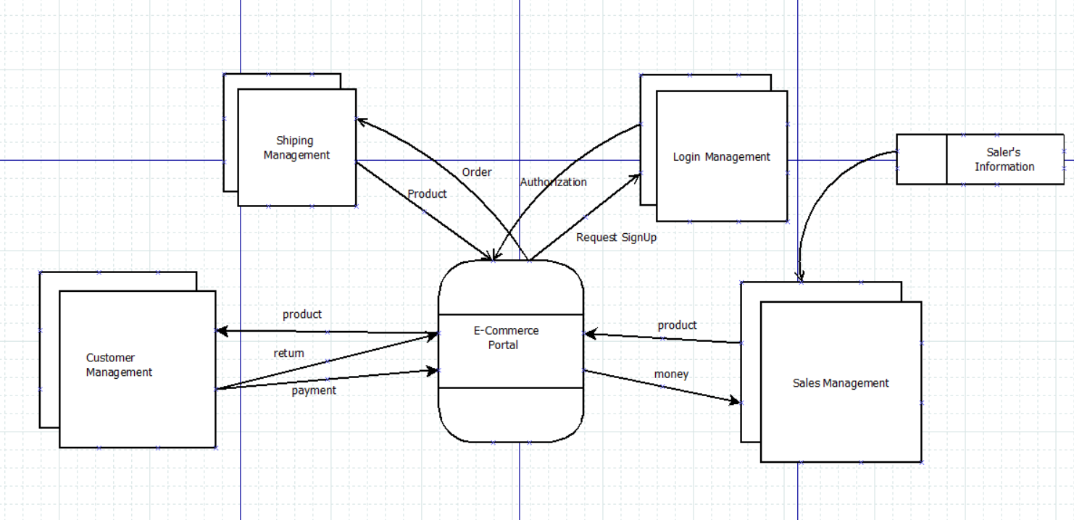
Data Flow Diagram (DFD) Level 0 DFD (Context Diagram)

Slide 17
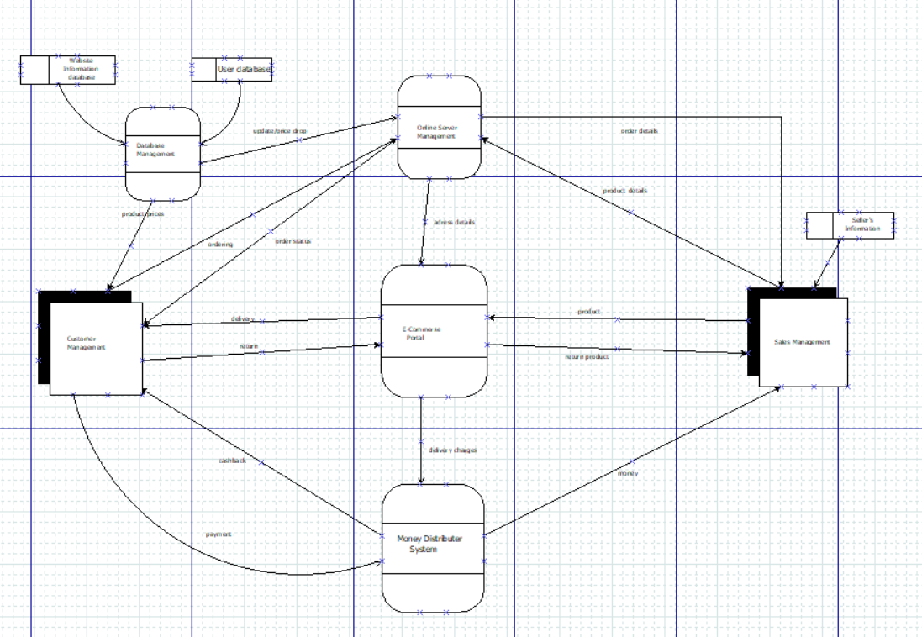
Level 1 DFD

Slide 18
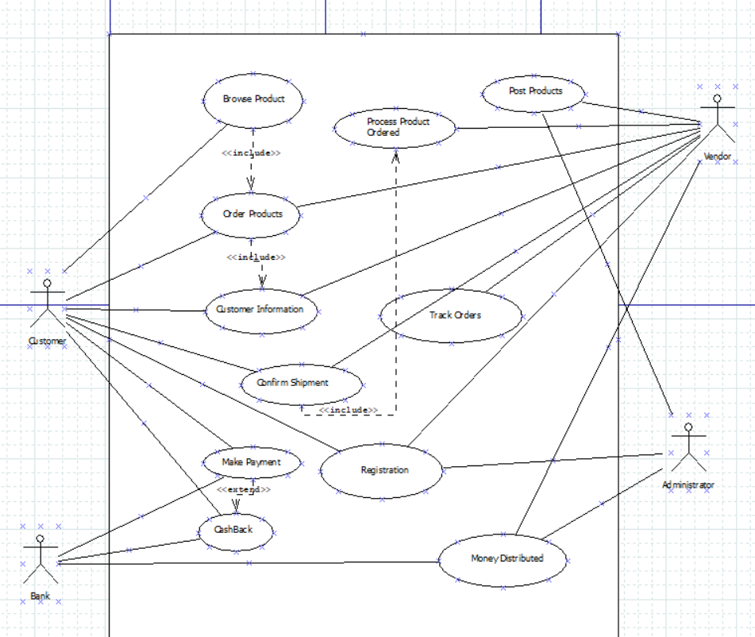
UML Use Case Diagram

Slide 19
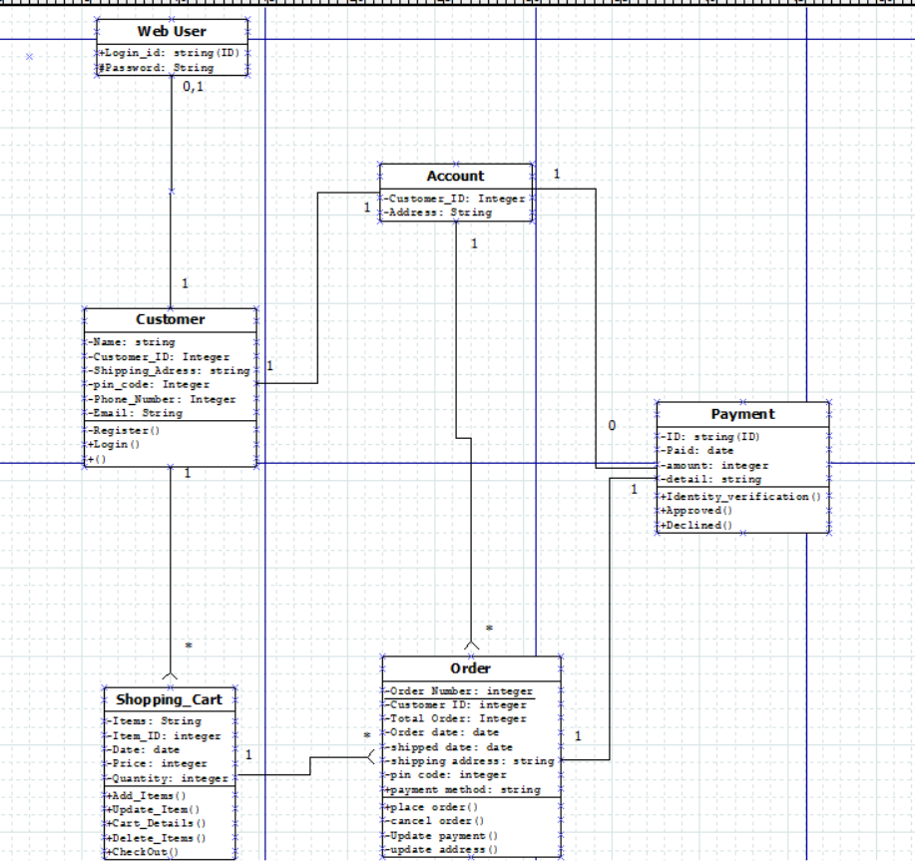
Class Diagram

Slide 20
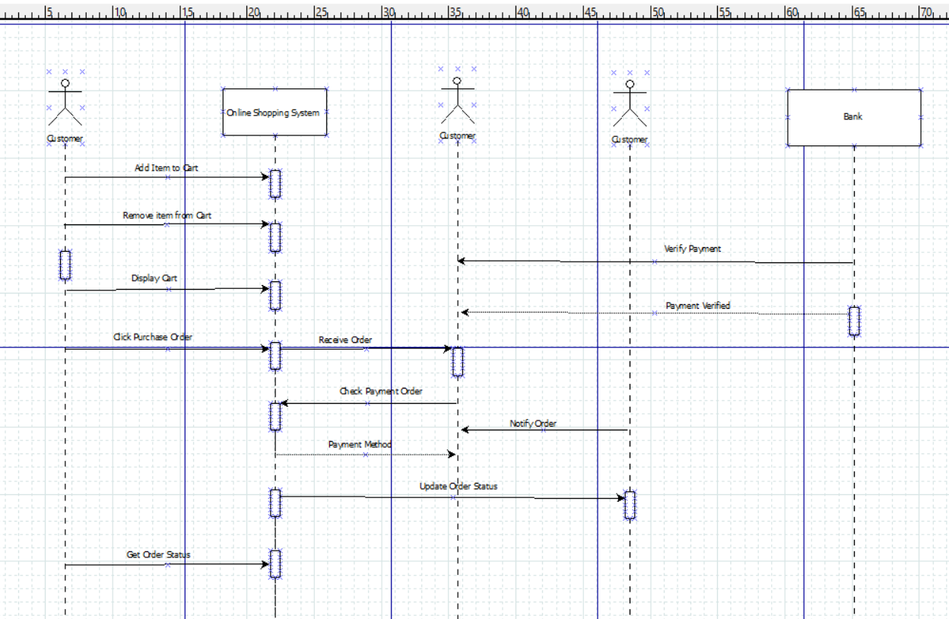
Sequence Diagram

